Slide 1

Opportunities and challenges for quantum-assisted machine learning in near-term quantum computers-
Alejandro Perdomo-Ortiz, Marcello Benedetti, John Realpe-Gómez, Rupak Biswas
For Papers we love Bhubaneshwar. Session II

Slide 2
whoami
My name is Ankit Jha and I’m in my penultimate year of engineering

Slide 3
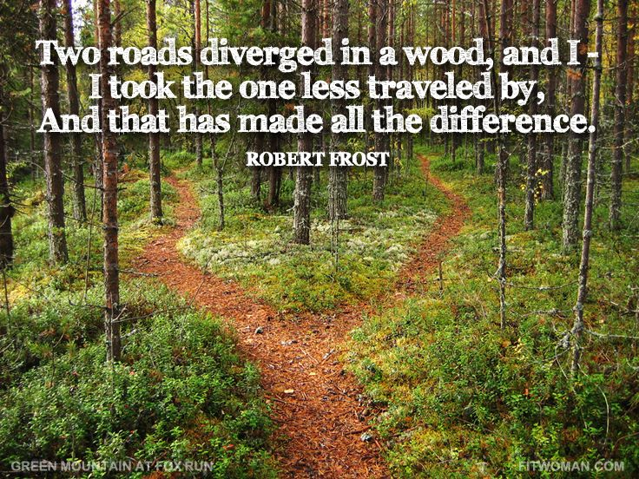
What is a classical computer?
A turing model problem solving machine, takes binary decisions

Slide 4
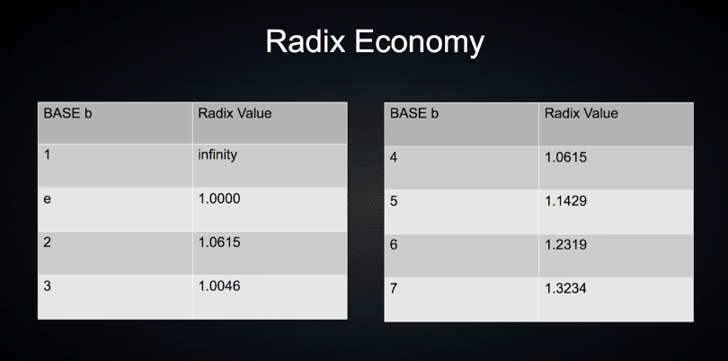
Ternary computing. Thinkihng beyond binary
What if we had a computer that would use a base 3 instead of a base 2. (We use k maps to represent the 3 states)

Slide 5
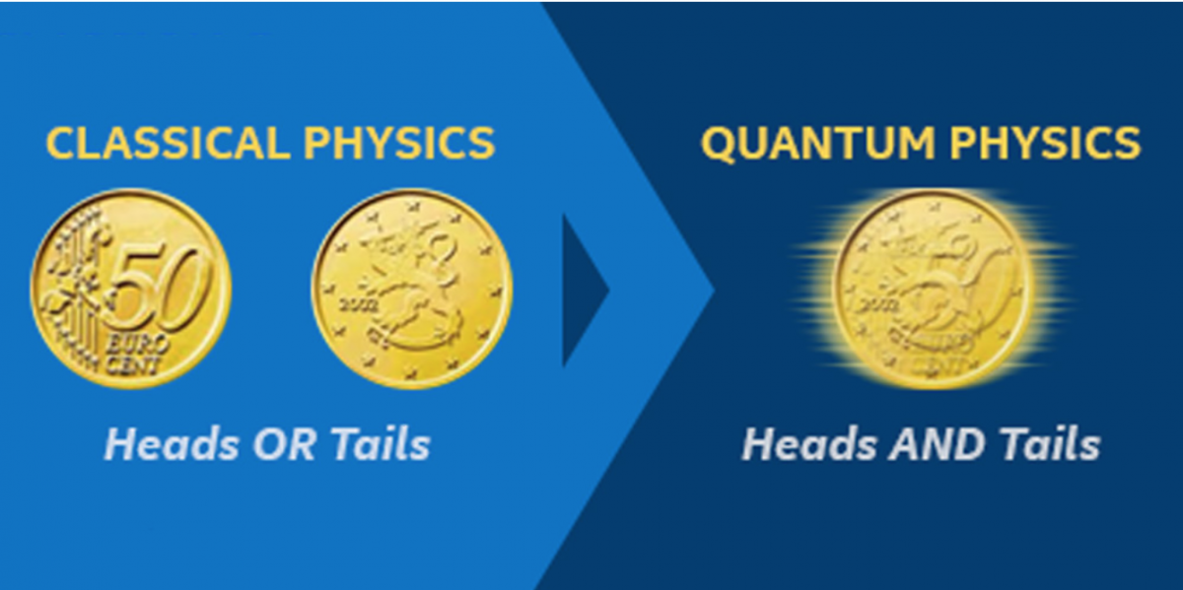

Quanta, Particles and superpositions
What adds the “super” to superposition? Uncertainty Principle

Slide 6
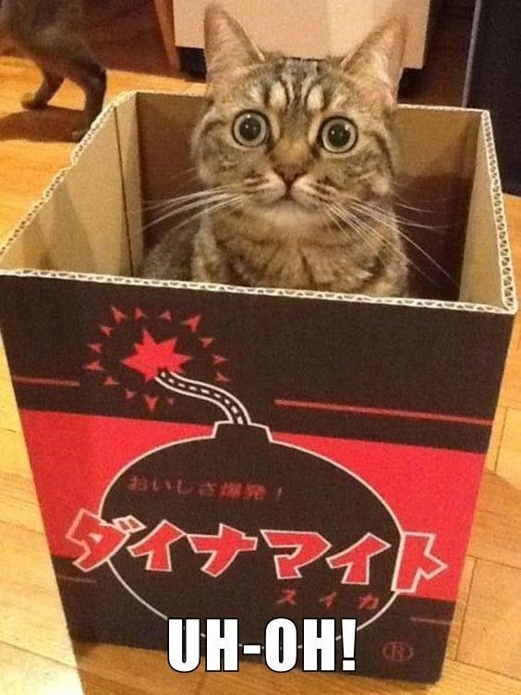
Superposition- Wanted: Schroedinger's Cat - Dead and Alive.﻿
Put a kitty in a box with gunpowder, let the powder blast. There are 2 outcomes- cat sees blast and dies or cat doesn’t see blast and lives but while it is in box it is both alive and dead.

Slide 7

Understanding entanglement of realities and quantum entanglement
All objects are waves.
Once these waves are split
and joined they behave
in the same way as
the two waves interfering
with each other.
This is same as
entanglement.

Slide 8
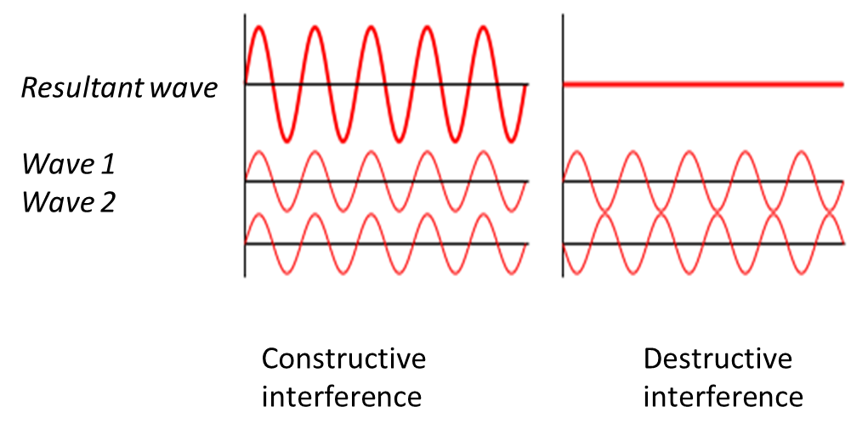
Interference

Slide 9
What if all our bits were superpositions?
What is data entropy? How many bits do we need to represnt data?
What will happen if we have infinite number of bits
Operations like addition, multiplication, blah blah.
An array is actually a mapping function between the index and the values.

Slide 10
What if we entangle all these bits together
What is a qBit or a quantum bit
Why can’t we just measure a qbit? (Wave function collapse and revelation of entanglement)
Classical correlation- a something is changed and another something changes. Like 2 envelopes problem
Q uantum correlation- Let’s play a cricket match world cup which is fixed

Slide 11
A recap of the uncertainty principle, Schrodinger equation , Hamiltonian symbol
Uncertainty- you can’t measure the position and momentum at the same time
Hamiltonian operator- total energy of the system. Veerything in Quantum mechanics has a operator for itself
Schrodinger equation- An equation that represents a relation between evrything else and gives a probabilistic wave fucntion for the system
Eignvalues- in time dependent schrodinger waves, the wave at a specefic time. (Not exactly this but let’s keep it that way)

Slide 12
Quantum Parallelism
Quantum parallelism arises from the ability of a quantum memory register to exist in a superposition of base states. (0 and 1). A quantum memory register can exist in a superposition of states, each component of this superposition may be thought of as a single argument to a function. So when some a function is performed to one component among all components in superposition, we basically perform it on all the components of the component set.

Slide 13
Solving our first problem
Take a contigious set of numbers-
A[]=0-1-2-3-4-5-6-7
We need to take every element and calculate 2*element (mod 7) where mod is the modulus operator
for(i in A[]):
A[i] <- (2*i)%7

Slide 14
Solving via using a Quantum computer
The probability of finding a 0 and 1 is 2/8 and for everything else it is 1/8
0 1 2 4 6 1 3 5 0
0 1 2 3 4 5 6 7
2xmod7

Slide 15
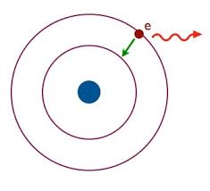
How did you do that?
Understanding ground state and excited states
Understanding how states get excited

Slide 16
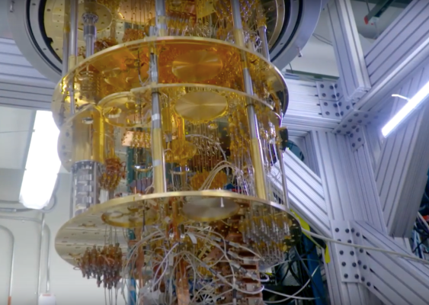
Why do machines need to stay cold

Slide 17
The Gates of Qunatum computers
Representation as superpostion of classical bits
Understanding of the classical gates
Why classical gates won’t work here
Hadamad, Cnot, Cx, cy, cz, Pauli, etc
All gates are unary matrices

Slide 18



Just getting an idea of what the Gates look like
Qbit= Ax[0> + Bx[1>
Here is Hadamad gate which makes probability of 0 and 1 same 0 becomes
and 1 becomes

Slide 19
Coding the ancient way
N 2 # create a new quantum bit and identify it as '2'
E 1 2 # entangle qubits '1' and '2', qubit 1 already exists and is considered input
M 1 0 # measure qubit '1' with an angle of zero (angle can be anything in [0,2pi]
# qubit '1' is destroyed and the result is either True or False
# operations beyond this point can be dependent on the signal of '1'

Slide 20
How do you code this D-Wave thing?
//Single Q Measurement
OPENQASM 2.0;
include "qelib1.inc";
// Register declarations
qreg q[1];
creg c[1];
// Quantum Circuit
measure q -> c;

Slide 21
Coding it with an interface
# single_q_measurement.py
from qiskit import QuantumCircuit, QuantumRegister, ClassicalRegister, execute
# Define the Quantum and Classical Registers
q = QuantumRegister(1)
c = ClassicalRegister(1)
# Build the circuit
single_q_measurement = QuantumCircuit(q, c)
single_q_measurement.measure(q, c)
# Execute the circuit
job = execute(single_q_measurement, backend = 'local_qasm_simulator', shots=1024)
result = job.result()
# Print the result
print(result.get_counts(single_q_measurement))

Slide 22
Structured code in Q
Qreg x1(); // 1-qubit quantum register with initial value 0 Qreg x2(2,0); // 2-qubit quantum register with initial value 0

Slide 23
Some more structured code in qcl
procedure main() {
qureg qstate[n];
qureg ostate[1];
measure qstate, outp;
print outp;
plot qstate;
dump qstate;
}

Slide 24
A brief summary of What we actually did
OpenQASM
Q
Qcl
Qiskit
Cirq
Q#
Why we won’t write any code here

Slide 25
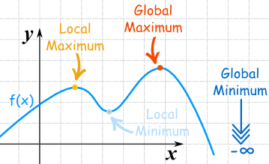
Introduction to minimization and maximization
An example of a linear growth function from the real world

Slide 26
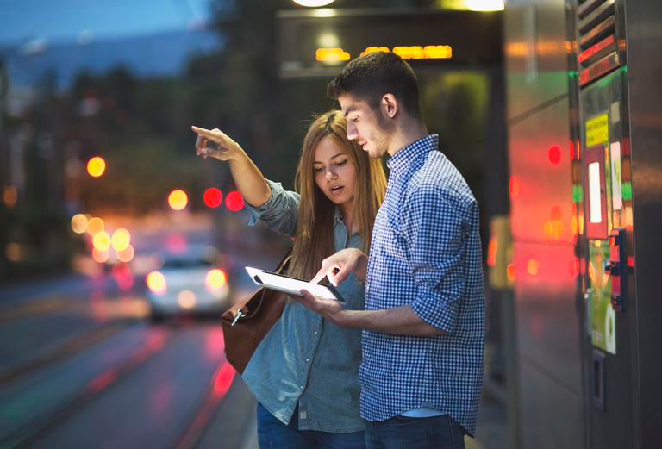
What are Heuristsics
something starts at a point and keeps moving in a direction. After every movement it checks itself and them continues moving. This is called Heuristics.

Slide 27
What are metaheuristics?
Searching for the Heuristics- It is a problem independent approach which means we can use the same approach to all problems (like in Tic Tac Toe we need Alpha Beta tuning and in TSP we need a search based approach but we cannot use Alpha Beta in TSP). Here we don’t know the underlying features of the problem. It is kind of a black box problem for example- Quantum annealing, genetic algorithms (Which are used for TSP or edge weight calculation for ANNs).

Slide 28
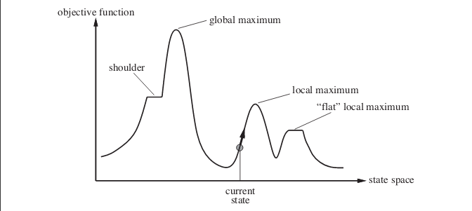
Example- Hill climbing maximization

Slide 29
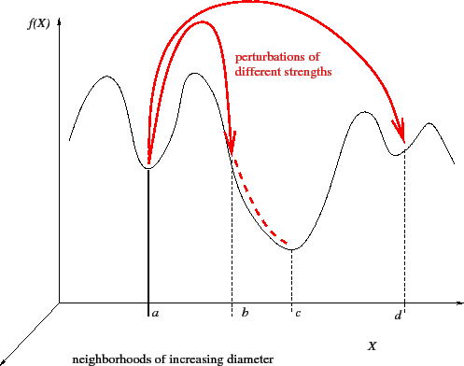
Randomized Hill Climbing

Slide 30
Qauntum Annealing and Fluctuation
Quantum annealing- It is a metaheuristic to find the global minimum of a loss function over a given state of candidate solution (it can be discrete as well as continuous) using Quantum Fluctuation.
Quantum Fluctuation- According to the uncertainty principle the energy of the quantum states keeps changing. This change in energy is called Quantum fluctuation.

Slide 31
How does Qauntum annealing work
0. We take a superposition of all possible states and system evolves time dependent
1. A potentially complicated Hamiltonian is found who’s ground state can be the solution of the problem.
2. A system with a simple Hamiltonian is initialized to the ground state
3. Then the simple Hamiltonian is evolved in the direction of the complex Hamiltonian
4. The time takes in equivalent to polynomial time computing problems for any problem

Slide 32
Let’s get started
Long term Quantum computers
Near term Quantum computers

Slide 33
What is this paper about?
This research focussed more on what we can do with the quantum machines that we have and that we are going to have in near future than to solve current problems with Quantum computers we’ll have in the next generation or maybe later
In case of interdisciplinary QML computationally expensive subroutines are outsourced to a quantum device and to analyze quantum states instead of classical data. QAML not to be confused with AQML (Applied Quantum Machine Learning) that uses ML to analyze Quantum experiments. The problems this deals with are basically for problems with statistically hard algorithms like Image and Speech recognition problems.

Slide 34
Let’s get started
Annealing vs Gate computers
Dwave
Instructions on What is about to happen

Slide 35
Use case 1
What kind of problems can near term Qcomputers colve?
Focus on problems which are intractable in the ML sphere (as in problems which have more of a Brute Forcing approach than an efficient algorithmic approach to be solved and problems which can’t be optimized) for example generative models in Unsupervised and Semi Supervised learning.

Slide 36
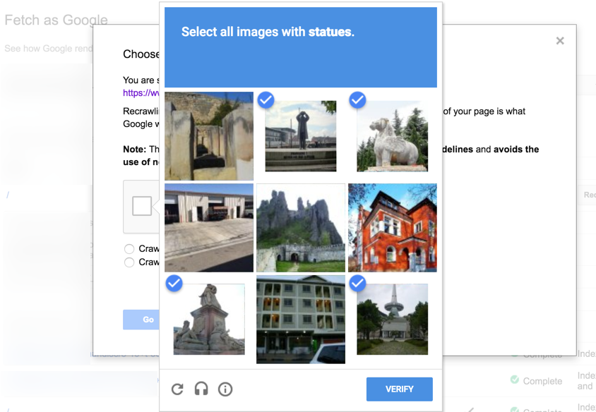
Labelled and Unlabelled data
Labelled data
Data that we know about for example pictures of cat or dog
Unlabelled data
Speech , images

Slide 37
Types of Learning
Supervised- Under a professor
Unsupervised- Self study. Figuring out on your own
Semi supervised- A coursera course with assignments duly submitted
Reinforcement learning- Chosing your IIT preparation coaching

Slide 38
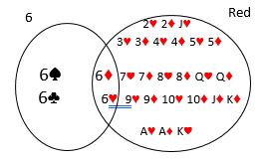
Joint probability
The probabillity of 2 events occuring together at a given time is called the joint probability – intersecting probability

Slide 39
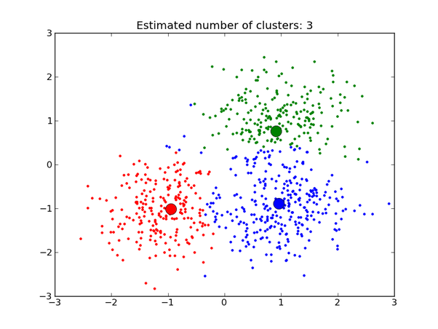
Generative vs Discriminative models
Discriminative model- you see the data and you classify it. Is it a car or a motobike?
Generative model- You see the data and wonder how it came from? What is a car? Try to draw it!

Slide 40
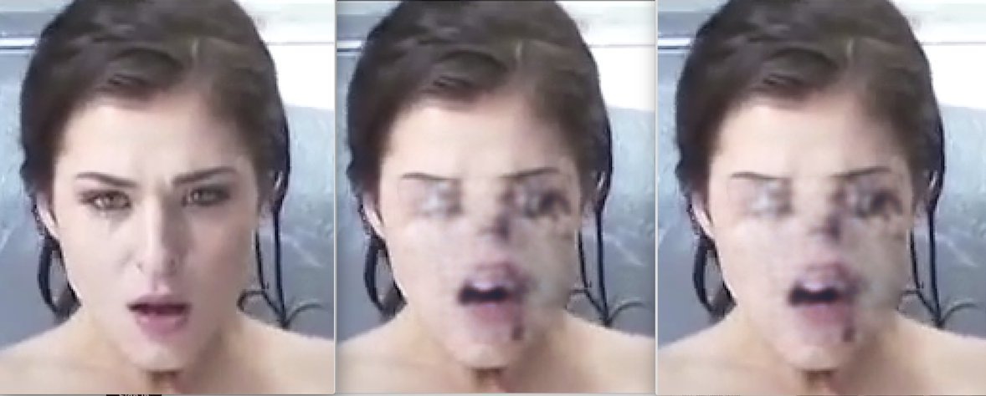
Implicit and explicit density estimator
Explicit- they assume a sample for example Monte Carlo sampling. They assume what kind of distribution it will be and
Implicit- now let’s play a game. GANs

Slide 41
Monte Carlo Markov Chain (MCMC)
We have a large data and we need to generate model
We take a large subset of data and try to predict the pattern in the data
We use the previous pattern as a stepping stone for next and so on
As much deep we go, the data becomes more and more arbitrary hence improving the model

Slide 42
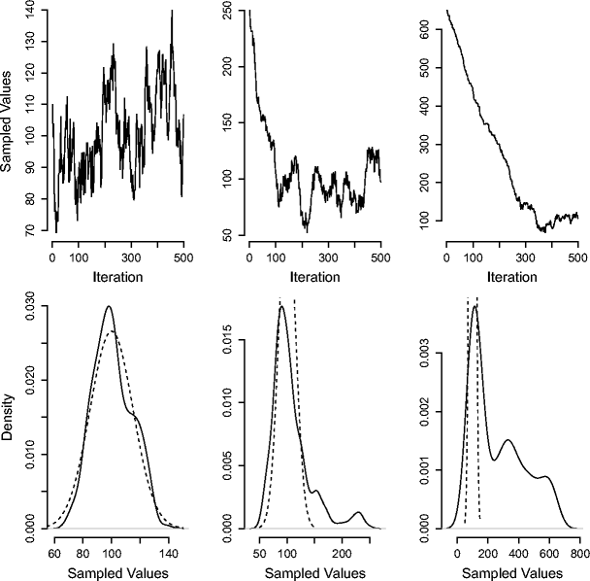
Metropolis approach
Metropolis approach- Keep taking proposals till amplitude of posterior is high or else keep adding values from noise. Generate a lot of proposals until we have enough samples. Use the last proposal to generate a chain

Slide 43
Limitations of this approach
The data moves very slow since the mixing is very very slow. You generate a lot of random numbers and attatch them to a chain and then try to generate more randomness. Randomness becomes increasingly difficult.
This can be solved by usig Quantum computers because jumping from one Markov Chain to another is easy because seperated by low density regions of relevant size

Slide 44
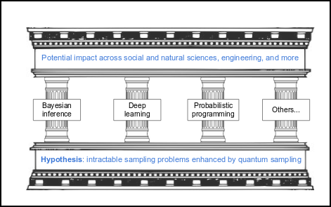
Impacts
We really don’t know what is happening here so this thing is called a gray box but as numbber of qBits increase, the thing will increasingly replace MCMC

Slide 45
Gibb’s Distribution
It is an approach to MCMC
It is like Metropolis Algorithm but it is a special case as in it accepts all proposals that come in
This is more efficient for the Quantum computers

Slide 46
Use case II
Focusing on datasets intrinsic to quantum-like correlations,making quantum computers indispensable which can be used on machines with 50-100 Qbits. Cognitive sciences problems can give us such datasets and we can use them in these domain specific problems specifically. Also can be implemented on classical datasets where Quantum like statistical correlations can be implemented

Slide 47

Someone who spends less money
Parsimonious models- A model that conveys a lot fo things using as few predictor variables as possible.

Slide 48
Akaike’s Information Criterion
It compares quality of a set of statistical models to one another
It uses software techniques, model fitting and relative differences
However it doesn’t tell if a model is good or bad
Just given a set of models, it chooses the best one.

Slide 49
Let us get this thing clear right now
ML algorithms can be sped up by using Quantum computers
The usability of a Quantum computer can only be judged by it’s ability to not compete against classical computers but to work along with them
Data represented by Quantum computers (even with limited number of Qbits) as shown by Google, leads in a superior performance to classical data modelling approaches. The data is to say Parsimonious and in accordance with Akaiske’s Information criteriation

Slide 50
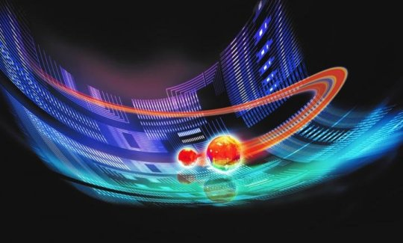
Case study 1- Molecular Modelling
Qauntum reactions can be modelled using Quantum computers because of entanglement property
world’s first simulation of a particle using Quantum computers

Slide 51
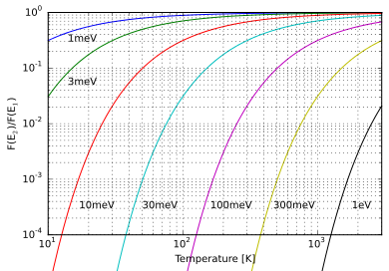
Case study 2- Boltzman Distribution and Maximum Entropy
The principle of maximum entropy states that the probability distribution which best represents the current state of knowledge is the one with largest entropy, follows Boltzman distribution

Slide 52
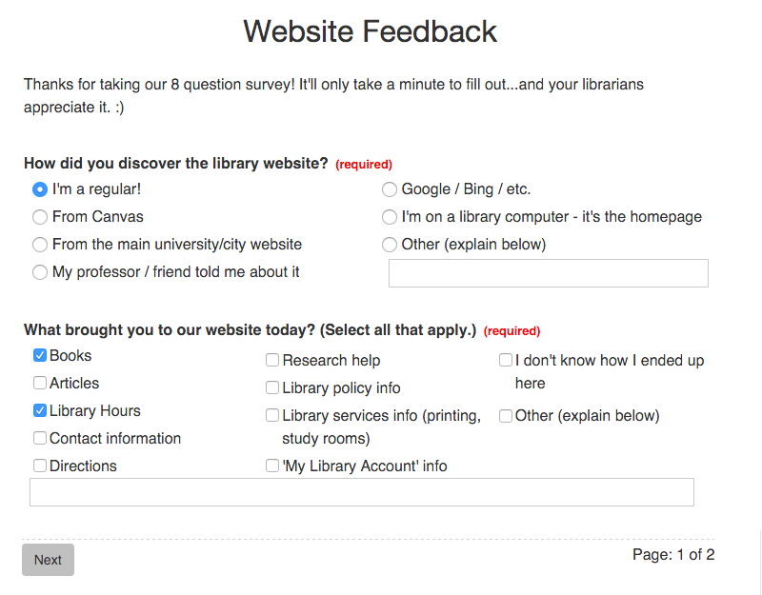
Case study 3: Cognitive science (Order problem)
Your answer to a question in a survey is dependent on the answer to the previous question
In case of 100s of questions and 100s of people this can be analysed by a Quantum computer

Slide 53
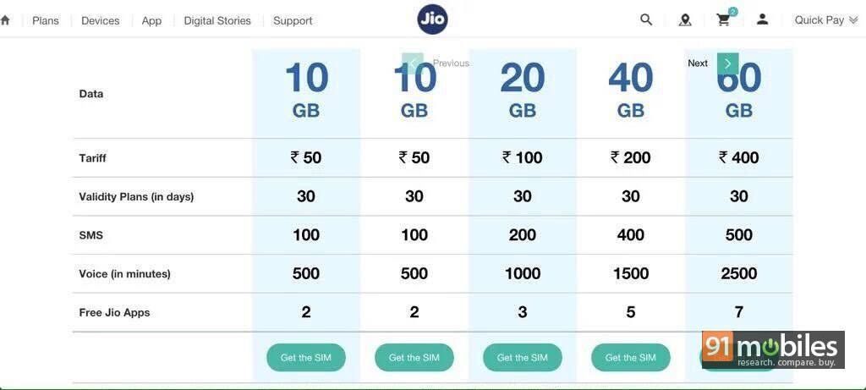
Case study 4: Cognitive biasses
You are given a game where you win $200 or lose $100
You play once and result is locked
If you get your result, what is your chance to play again
If your result is secret what is your chance to play again

Slide 54
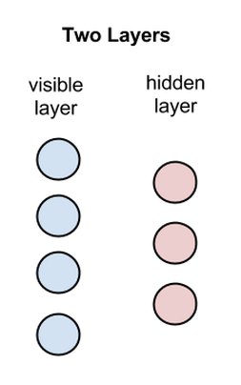
Let’s get things clear. What are Restricted Boltzman Machines actually?
Developed by sir Hinton they are predecesors of modern day Neural Networks
Each of these are called nodes
where calculations take place
There are no intra layer
communications going on

Slide 55
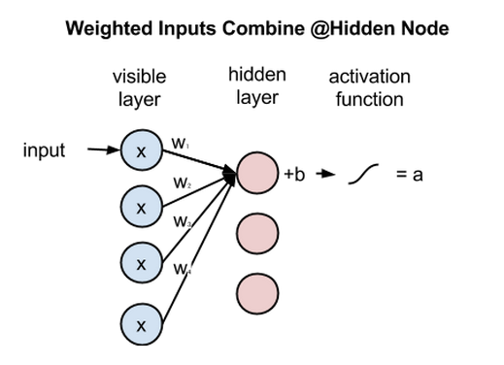
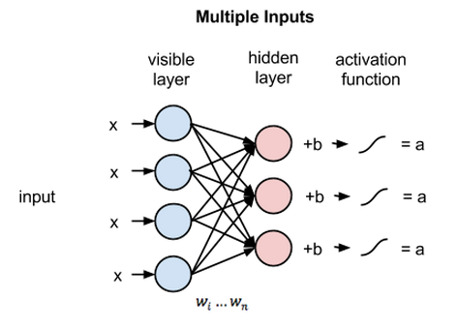
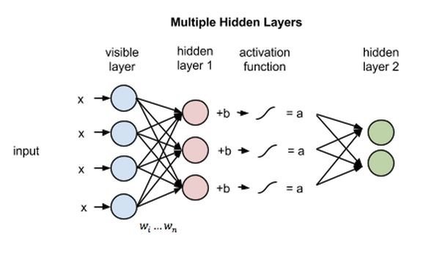

Slide 56
Let’s actually break down how the whole thing works for everyone
So the data is broken down into pieces
A reconstruction of the network is carried out which tries to obtain the probability distribution of the input dataset
Using this generative model we make a network that is called a boltzman machine
If there is no relationship between the initial data it is a restricted Boltzman machine

Slide 57
Fully Visible Boltzman Machine
The parameters are learned from input data by maximizing the log likelihood (a measure of AIC better model) which means, the parameters are made into a better model by taking the input data into account.
These models can be trained on Quantum annealing hardware to imrove efficiency and they are used for convexity and tractability

Slide 58
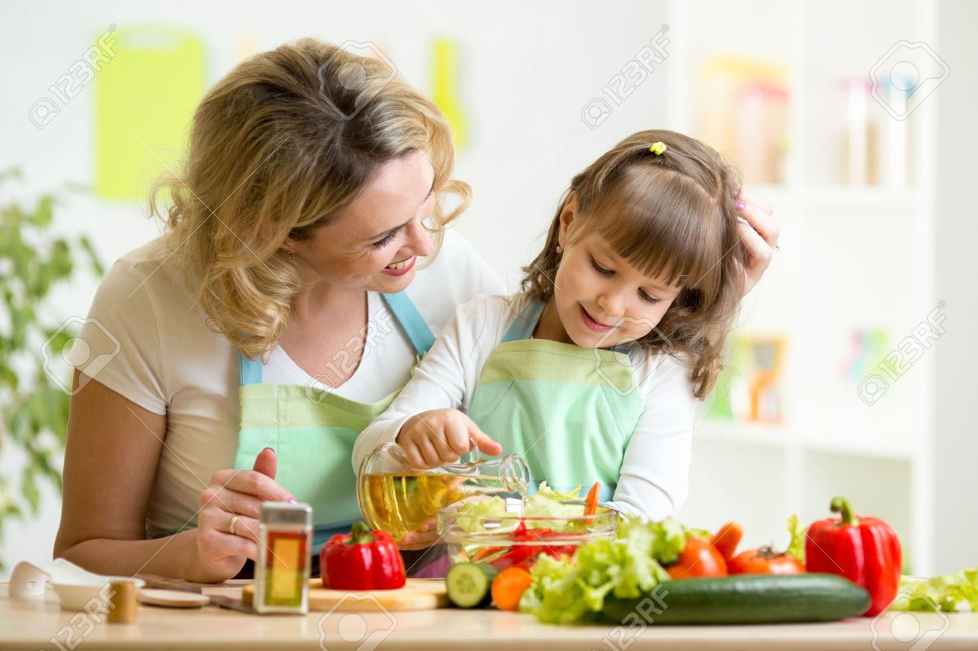
Contrastive Divergence
The process to generate a chain of possible values using initial possible value (input value) while satisfying a particular constraint

Slide 59
Solving Linear set of Equations- HHL Algorithm
Harrow-Hassidim-Lloyd algortihm or HHL algorithm
If A is an NxN Hermatian matrix (Matrix which is equal to it’s own conjugate transpose), the solution for Ax=B is calculated using this process.
The value of x is not calcultaed bu the associated scalars are calcultaed
It’s proof gives a minimum time complexity of O(log(N)k²) which is a significant speed up

Slide 60
Developing a Quantum recommendation System
The author develops his own data structure for matrix sampling having polynomial complexity
Then bypasses the restrictio of HHL
Takes in input of several million datasets and gives output

Slide 61
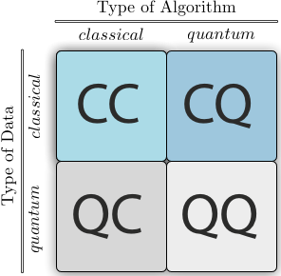
Use case 3
Some classical ML algorithms have an intractable subroutine. We can use Quantum computing to develop hybrid algorithms to execute the intractable step.

Slide 62
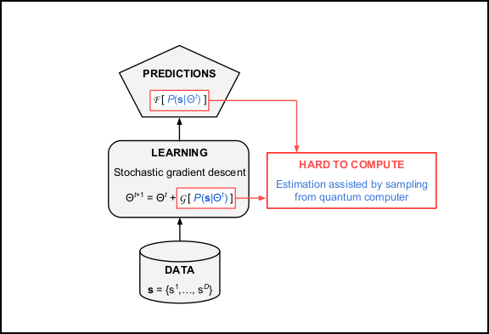
How hybrid algos work

Slide 63
Limitations of QAML 1: Communication
We design a hybrid network example say Boltzman machine
It needs 2 inputs to maintain bipartite structure
Positive phase is better on classical computer
Negative phase is intractable so better on Quantum computer
So we rely on Gibb’s distribution from physical process
But we do not have any control of the temperature
This does result in a lot of erros

Slide 64
Limitations of QAML 2: Noise
Some Quantum machines have an intrinsic noise
What that means is the freezing in Quantum annealing can create unnecessary noise in the system which can divert the data and cause unnecessary peturbation
We can solve it by specifying a particular model and not have a random model but that would not be in line with structure of Quantum device

Slide 65
A very good possible solution
Using a grey box approach
Assume data come from MCMC distirbution
Still work from initial data
For example having a proxy to check if we are moving in the correct direction of the gradient
But the problem is anytime we need to do a reconstruction or generation we will need to use the same Quantum device for that. No classical computing so we will have to train our models likewise

Slide 66
Helmholtz Machine
It contains 2 things- a network that goes bottom up. That is, it tries to generate a pattern in the data
The second that tries to generate the data itself which is the recognition phase
The problem is to find the value of the hidden variables in the data.
The training is alternate in nature and is called Wake and sleep

Slide 67
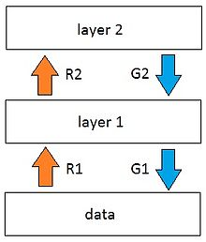

Intution
Imagine you wake up and you decide to do your bed and everything
And then while at night you try to minizmie the expenses for the month based o your daily activities

Slide 68
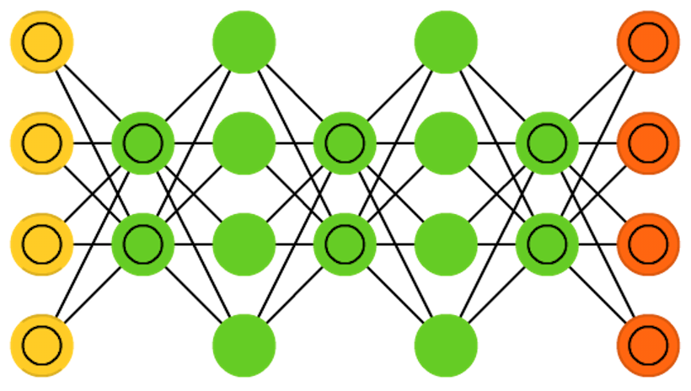
Getting deeper into the netwrok
The hidden layers contain a 0 and 1
They go deeper and deepr and as deep as we go, we try to model more abstract features than before

Slide 69
Solution approach 1
Model the deepest layer into a Quantum sampling
Measure hidden variables for each data point in the training set
Now that we have a classical Neural Network we can solve it using classical computing
We also have a reduced dimension of data and since Quantum device is only usable for binary data, we have that going on for us too

Slide 70
Approach 2
Restrict the recognition to be classical
Speed it up by using serial Quantum devices
Use a Deep Neural Network to carry out the recognition task
Use Quantum assisted generator network
Use this KL divergence to find distance between the two distributions and implement the Wake-Sleep appraoch to minimize that

Slide 71
Example: Generation of Handwritten digits
Complex data is data with more variables than available qbits and data can be discrete as well as continious
The generator network is on the right and the recognizer is on the left
The hidden variables are set by the generator network
The model does not simply emorize the training set, but rather reproduce its statistics.

Slide 72
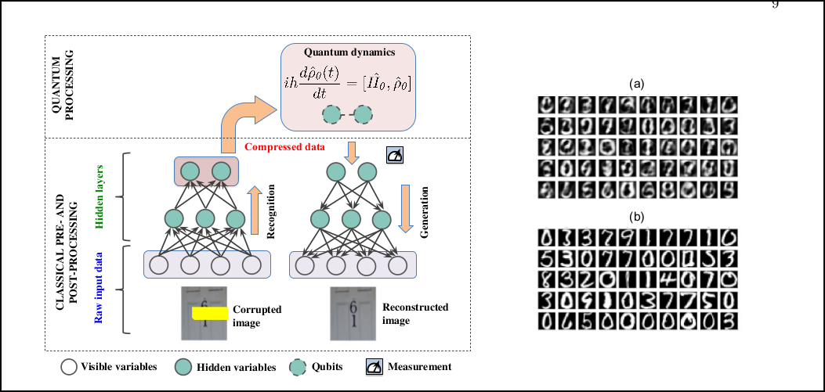

Slide 73
Limitations of QAML 3: Connectivity
Topological connectivity- Physical connectivity is only limitted in nature
Qbit to qbit interaction will cause a lot of overhead expenses in the device
In case of annealing devices a larger problem is to set the parameters of the devices
Embedding parameters into equations can be solved by Heuristic search but will they be connected

Slide 74
Limitations of QAML 4: Non Binary datasets
Quantum computers at the moment are good at performing operations on non binary dataset
But most data like images and speech are non binary in nature
In the long term we could use the amplitudes of the dataset to represent complex datasets or we could develop approaches to model complex ML datasets but right now we do not have the tech

Slide 75
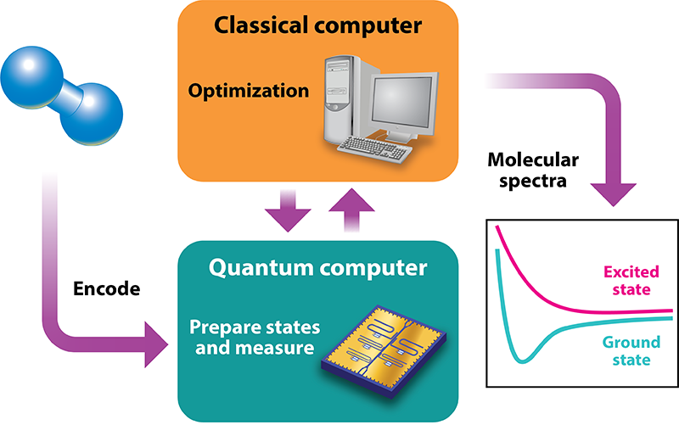
Solution
Use Quanrum computers to model only Hidden variables which are binary in nature
Use classical computing to model everything else

Slide 76
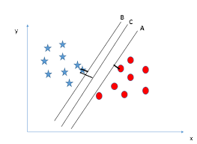
A crash course into SVM
Stay away from me!

Slide 77
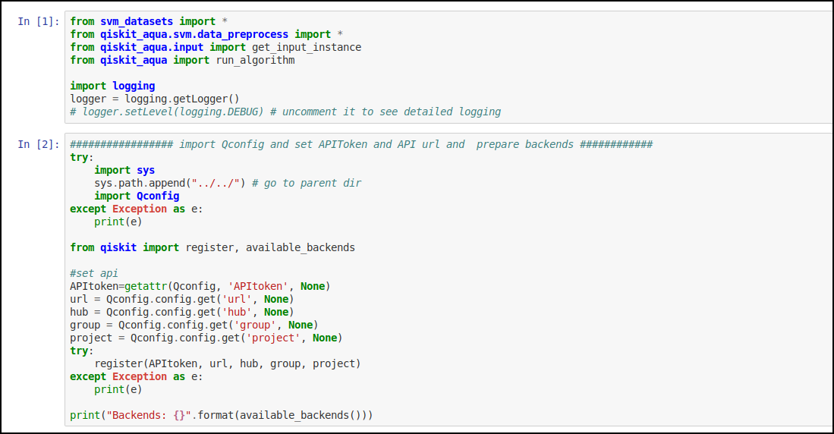

Slide 78
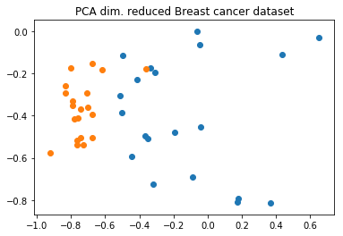

Slide 79
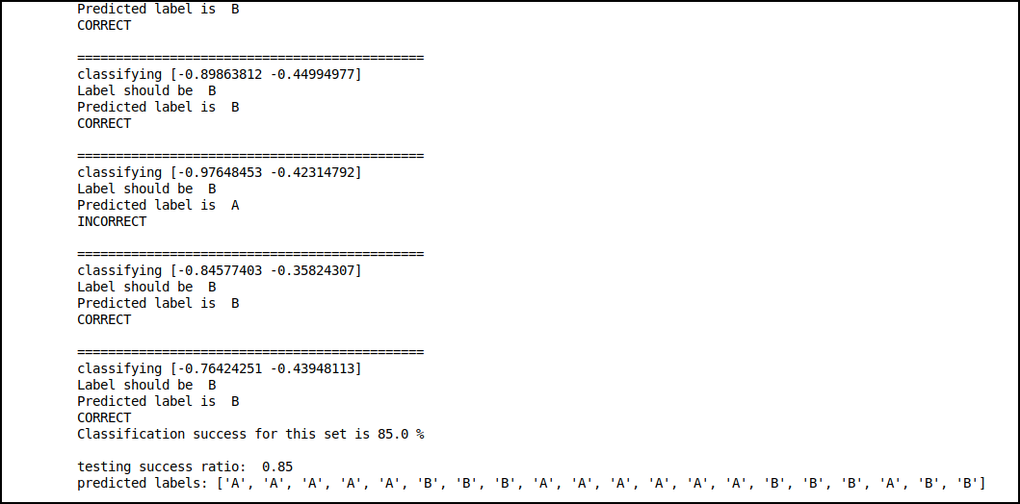
Output

Slide 80
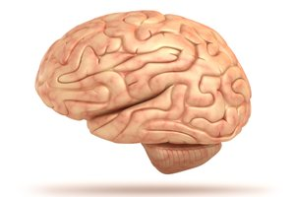
Let’s create a human brain. The long term vision and how

Slide 81
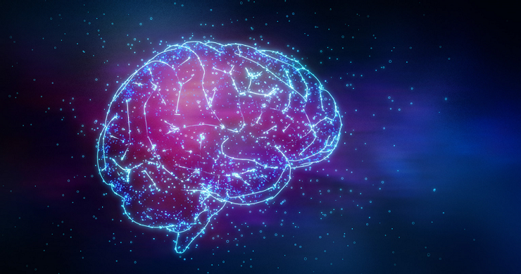
Consciousness as a Quantum problem

Slide 82
THANK YOU

